Slide 1
SHAMIKSHA R
FINAL PROJECT
3/21/2024 Annual Review

Slide 2
PROJECT TITLE
COLORIZATION OF IMAGES
3/21/2024 Annual Review

Slide 3


AGENDA
Problem Statement
Project Overview
Who are the end users ?
Your solution and its value proposition
The wow in the solution
Modelling
Results
3/21/2024 Annual Review

Slide 4

PROBLEM STATEMENT
Despite advancements in image processing, the task of accurate and efficient colorization remains a challenge. Traditional methods often lack precision and require extensive manual effort, while automated approaches face issues of consistency and artifact generation. Additionally, ethical concerns arise when colorizing historical or culturally significant images. There is a pressing need for innovative solutions that balance accuracy, efficiency, and respect for the integrity of the original content.
3/21/2024 Annual Review

Slide 5

PROJECT OVERVIEW
Colorization of images involves the process of adding color to monochrome or grayscale images to make them appear realistic and visually appealing. Traditionally, this was done manually by artists, but with advancements in technology, automated methods, especially those based on deep learning, have gained prominence.
3/21/2024 Annual Review

Slide 6

WHO ARE THE END USERS?
The end users for colorization of images vary across different industries and fields. Some of the key end users include:
Photographers and Graphic Designers
Film and Media Industry
Historical Preservation Organizations
Educational Institutions
Marketing and Advertising Agencies
Medical and Scientific Research
General Public
3/21/2024 Annual Review

Slide 7

YOUR SOLUTION AND ITS VALUE PROPOSITION
SOLUTION:Colorization of images
Our proposed solution is an advanced image colorization software powered by state-of-the-art deep learning algorithms. This software combines the precision of manual colorization with the efficiency of automated methods, providing users with a user-friendly interface and robust functionality.
VALUE PROPOSITION:
Accuracy and Efficiency
Versatility
Enhanced Visual Communication
Aesthetic Enhancement
3/21/2024 Annual Review

Slide 8

THE WOW IN YOUR SOLUTION
Our image colorization software offers a comprehensive solution that combines advanced technology with user-friendly design, providing value to a wide range of users across industries while upholding ethical standards and preserving cultural heritage.
Ease of Use
Realism
Enhanced Creativity
Ethical Considerations
3/21/2024 Annual Review

Slide 9
MODELLING
Colorization of images often involves the utilization of various models, primarily within the realm of deep learning, to achieve accurate and visually appealing results. The choice of modeling approach depends on factors such as the availability of labeled data, computational resources, desired level of accuracy, and specific characteristics of the target application or domain.
3/21/2024 Annual Review

Slide 10
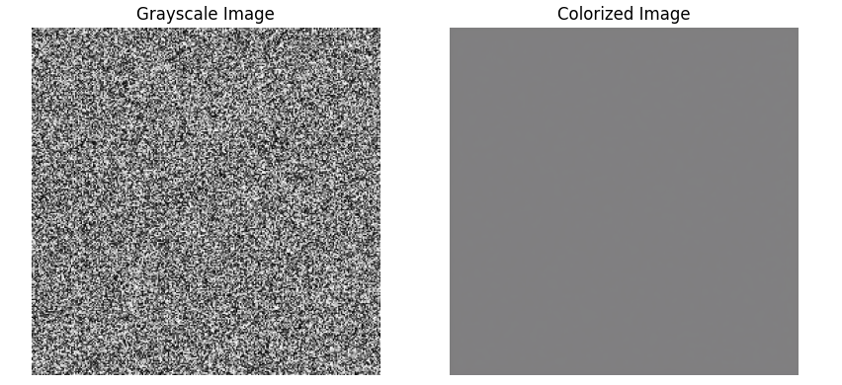
RESULTS
The results of our image colorization can vary based on the specific techniques, models, and datasets used in the process.In this case, it results in the natural and belivable colorization of the images for the observers.It ensures a consistent colorization of the images that colors are applied uniformly across the image, maintaining coherence and harmony in the overall color scheme. It preserves fine details and textures present in the grayscale input image.
3/21/2024 Annual Review

